Slide 1

Ticket Monitor
A snow ticket monitor native application

Slide 2
WHAT IS THE PURPOSE OF THIS TICKET MONITOR APP?
I have proposed to create this app as according to my experience as a DM, the Snow application itself has some lacking functionalities that are specific for BIOps team for which I wish to extend.
Automate monitoring of tickets.
Show the summaries of the tickets by segregating them by priority and status.
Giving highlight to what ticket that needs update instead of going through all the tickets.
Provide a better way of reminding the user of the ticket that needs attention by pushing a notification and in the dashboard.
Help promote on lessening or eliminate on breaching the SLA of the ticket.
NOTE:
This is NOT a replacement of the main functionality of P&G SNow ticket application.
Does NOT directly connects to any of the database of P&G.

Slide 3
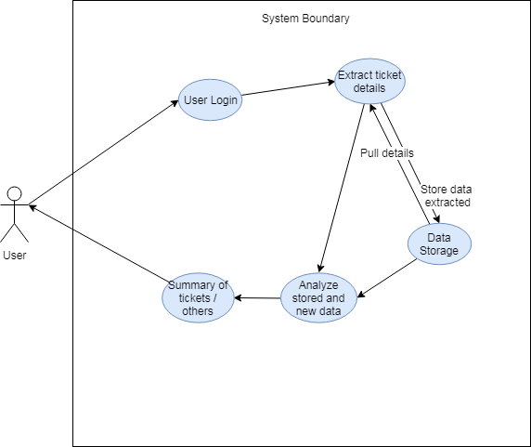
Use Case Diagram
The boundary of the application

Slide 4
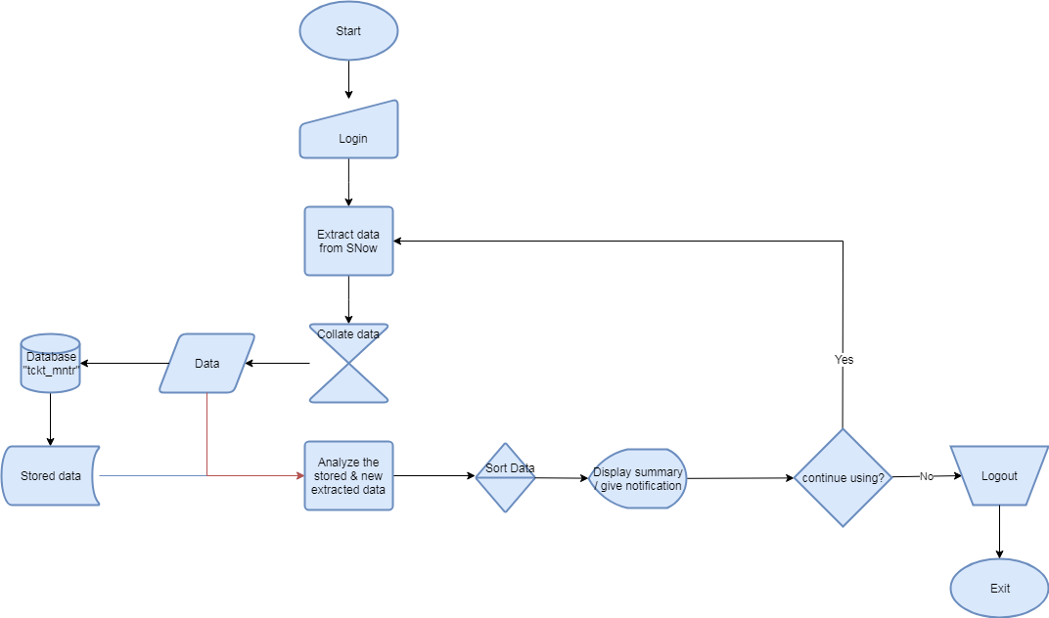
System Flow Chart

Slide 5
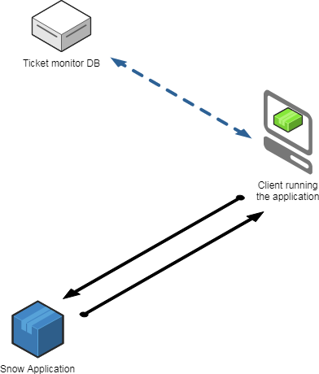
Network Flow Diagram
Network flow of the data

Slide 6
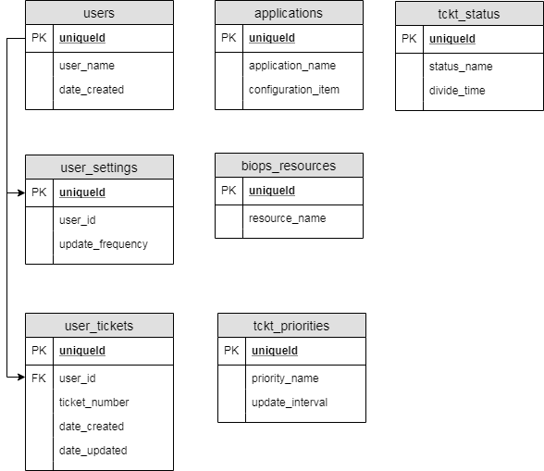
Database Structure

Slide 7
Tools that will be used
Frontend:
Html - is the standard markup language for creating Web pages.
React - A JavaScript library for building user interfaces.
CSS - is a language that describes the style of an HTML document.
Electron – is an open source library developed by GitHub for building cross-platform desktop applications with HTML, CSS, and JavaScript.
Backend:
Nodejs - is a JavaScript runtime built on Chrome's V8 JavaScript engine that is very useful for building network application or server.
Puppeteer - is a Node library which provides a high-level API to control Chrome or Chromium over the DevTools Protocol.
MongoDB - is a free and open-source cross-platform document-oriented database program where in our case we’re using mlab as database as a service.

